Slide 1


Immersive Python Workshop
January 9 and 10th, 2025
Day 1 (Virtual)
Presented by the
UT Libraries &
Open Source Program Office (UT-OSPO)
UT-OSPO
UT Austin Open Source Program Office
Sloan grant number: G-2023-20944

Slide 2
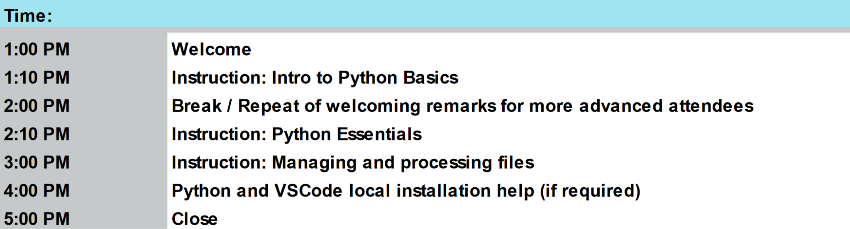
Itinerary for the Day

Slide 3
Land Acknowledgement
We would like to acknowledge that we are meeting on the Indigenous lands of Turtle Island, the ancestral name for what now is called North America.
Moreover, (I) We would like to acknowledge the Alabama-Coushatta, Caddo, Carrizo/Comecrudo, Coahuiltecan, Comanche, Kickapoo, Lipan Apache, Tonkawa and Ysleta Del Sur Pueblo, and all the American Indian and Indigenous Peoples and communities who have been or have become a part of these lands and territories in Texas.
Notes:
[]Link to the full UTL land acknowledgement- https://www.lib.utexas.edu/land-acknowledgement-statement

Slide 4
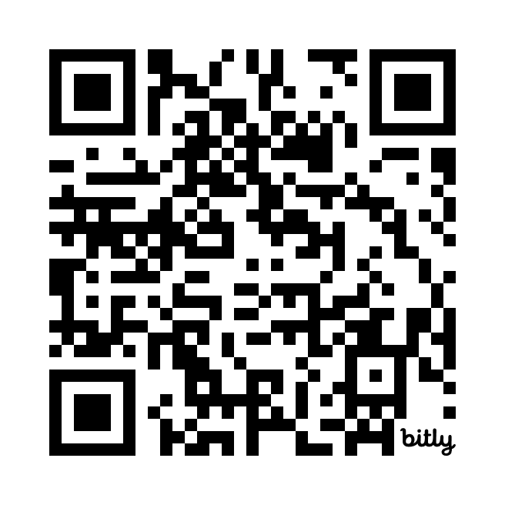
Logistics
Shared notes document (https://bit.ly/ipw-jan2025)
Important URLs will be provided here
Asking questions
Timing of breaks
Workshop materials and slides will be posted on GitHub
Further logistics for our in-person day tomorrow will be shared at the start of the Friday session
QR code for shared
notes document
Notes:
The following Zoom features are perhaps familiar to many people by now, however we would like to spotlight some of the zoom features we’re suggesting you may use today. The image shown is a representation of what your zoom screen most likely displays on your device.
Hover your mouse over the bottom of your Zoom window to see the icons.
First note the person icon, highlighted in a red box. Click and open the “Participants” window. If you click next on “More” you should see the option to rename your profile to your preferred name. This can also be done by going to your profile picture in the zoom gallery and clicking on the three ellipses “...” - you can update your profile picture here as well.
2nd, use the chat icon, highlighted in a blue box on this image, to open your chat window. Reminder to type the words “QUESTION” or “HELP” with your comments. Our helpers and hosts will be monitoring the chat. Please type a greeting to test your chat.
Finally, our instructors may be using Zoom reactions during their lesson. This image shows the reactions icon, a smiley face, highlighted in a green box. Click on your reactions icon below our slide, and it should open options like shown in the larger green box. Wave, thumbs up, a green circle with a white check mark for “yes” and a red circle with a white x for “no.”.

Slide 5
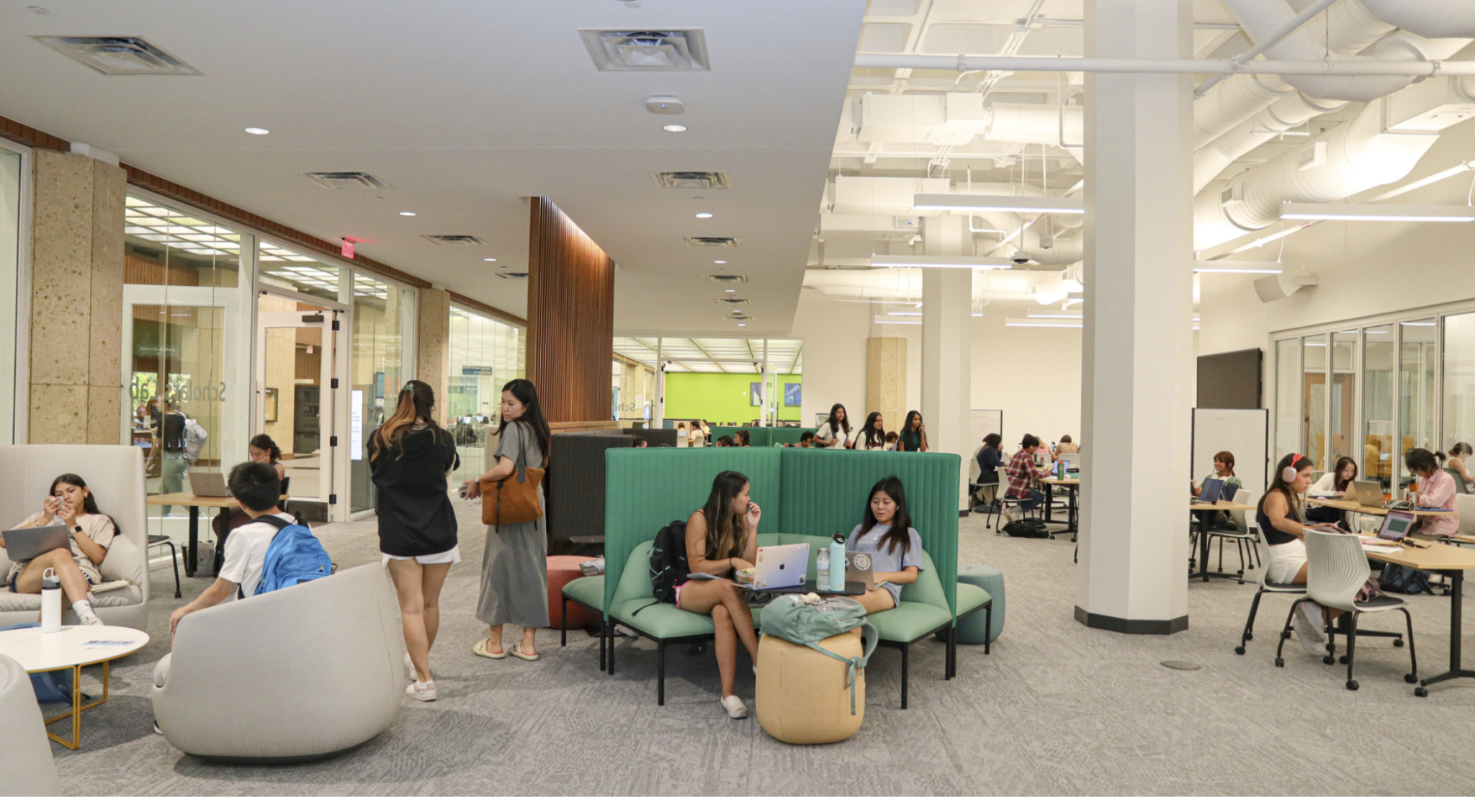
Utilizing the Scholars Lab
Data Lab
Data and Donuts
Digital Humanities Workshops
DH Day
More
Project Rooms
Digital Scholarship related projects
Reservable
Scan Tech Studio
Supports Optical Character Recognition and Handwritten Text Recognition
Scanners and PC
Reservable
Digital Scholarship Consultation
Notes:
We have enabled live captions on Zoom. So long as I remember to turn them on, you should see them, and if they distract you or you need them to look different, you can adjust the display settings individually to your preferences.
Before I move into the last section of pre-workshop logistics and housekeeping items, are there any questions about what we’ve just gone over?

Slide 6
Instruction Team
Instructors:
Michael Shensky (Head of Research Data Services)
Jeremy Thompson (Digital Processing Archivist)
Alex Marden (GIS and Geospatial Data Coordinator)
Ian Goodale (European Studies Librarian)
Bryan Gee (Open Research Coordinator for Data and Software)
Karina Sanchez (Scholars Lab Librarian)
Helpers:
Grant Hardaway (Psychology and Life Sciences Librarian)
Meryl Brodsky (Information & Communication Librarian)
Notes:
Please ask the instructors to introduce themselves.
Perhaps the helpers will indicate they are a helper by putting the word helper next to their name in the participants?
[[Following introduction, STOP SHARE, Allow Anna to take over PRESENTATION.REMINDER TO START RECORD….

Slide 7
Code of Conduct
Use welcoming and inclusive language
Be respectful of different viewpoints and experiences
Gracefully accept constructive criticism
Focus on what is best for the community
Show courtesy and respect towards other community members
Contact any Helper or Instructor for assistance
Notes:
The full Carpentries Code of Conduct can be found at this link. The basic tenets are
Use welcoming and inclusive language
Be respectful of different viewpoints and experiences
Gracefully accept constructive criticism
Focus on what is best for all of us
Show courtesy and respect towards each other
Please contact any of us who are facilitators or instructors with any code of conduct concerns, and there is also an incident report form on the Carpentries Code of Conduct page.

Slide 8
Day 1
Intro to Python

Slide 9
Goals for the Intro to Python Section of the Workshop
Introduce the fundamental knowledge required to help you get started using Python
Provide information about related resources you can use to learn more about Python moving forward
Showcase the benefits of using Python for reproducible research
Learn how to use Python without installing any software - this workshop will use Google Colab
We will focus on using a local Python installation during tomorrow’s session

Slide 10

What is Python?
Open source, interpreted programming language
Cross platform compatible (Windows, MacOS, & Linux)
Extensive use in a variety of fields
Large ecosystem of open source packages
Can be used for file management, analyzing data, editing data, visualizing data, and more!

Slide 11
Why is Python Important?
Efficiency | Automated process can save hours, days, or even weeks of time
Reproducibility | Code can be shared with other researchers so they can verify your results and learn from your methods
Collaboration | Code can be shared and collaboratively developed on platforms like GitHub and GitLab
Scheduled tasks | Processes can be set to run at specific times or can be triggered by set events
Creativity | Usually more interesting to write code to automate a tedious process than do it manually

Slide 12
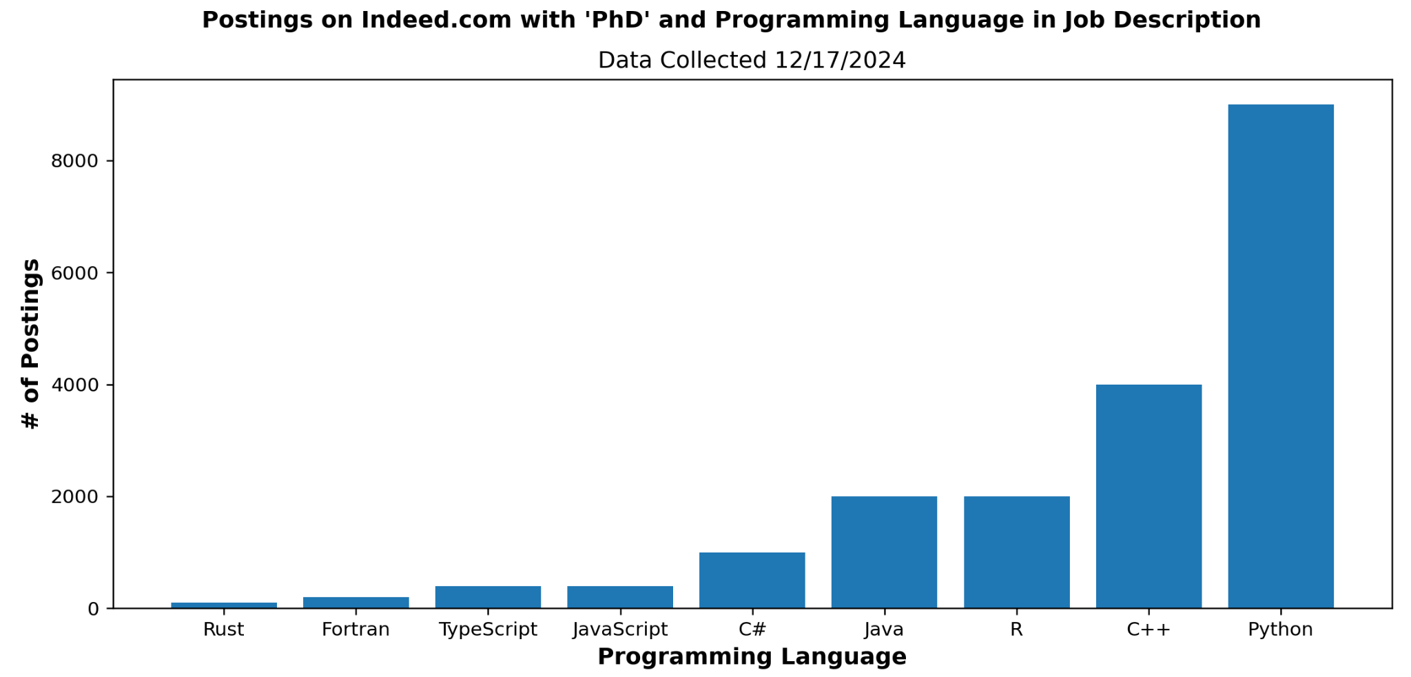
Why Focus on Python Specifically?

Slide 13
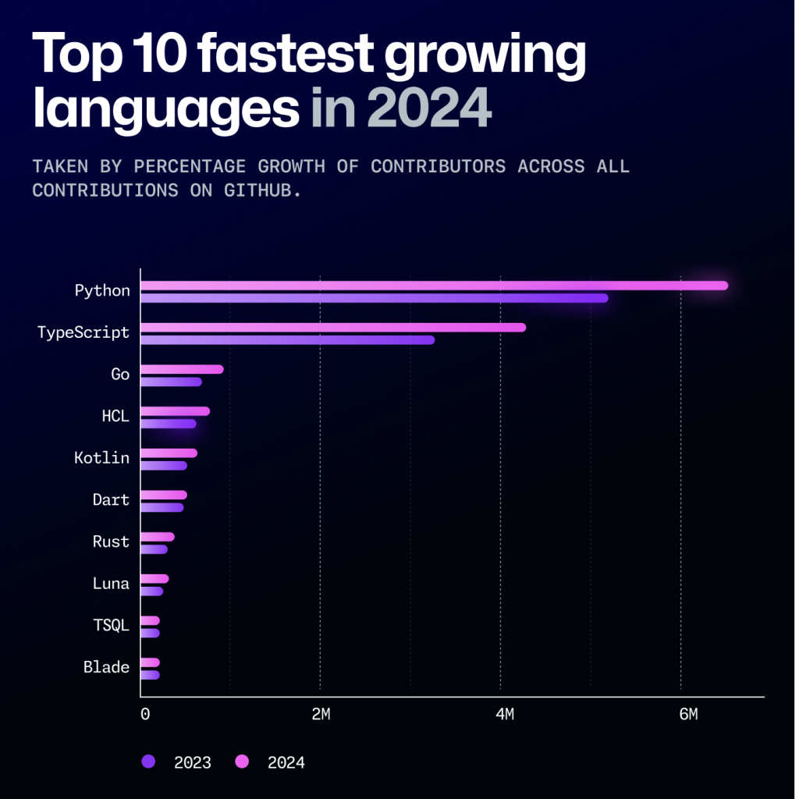
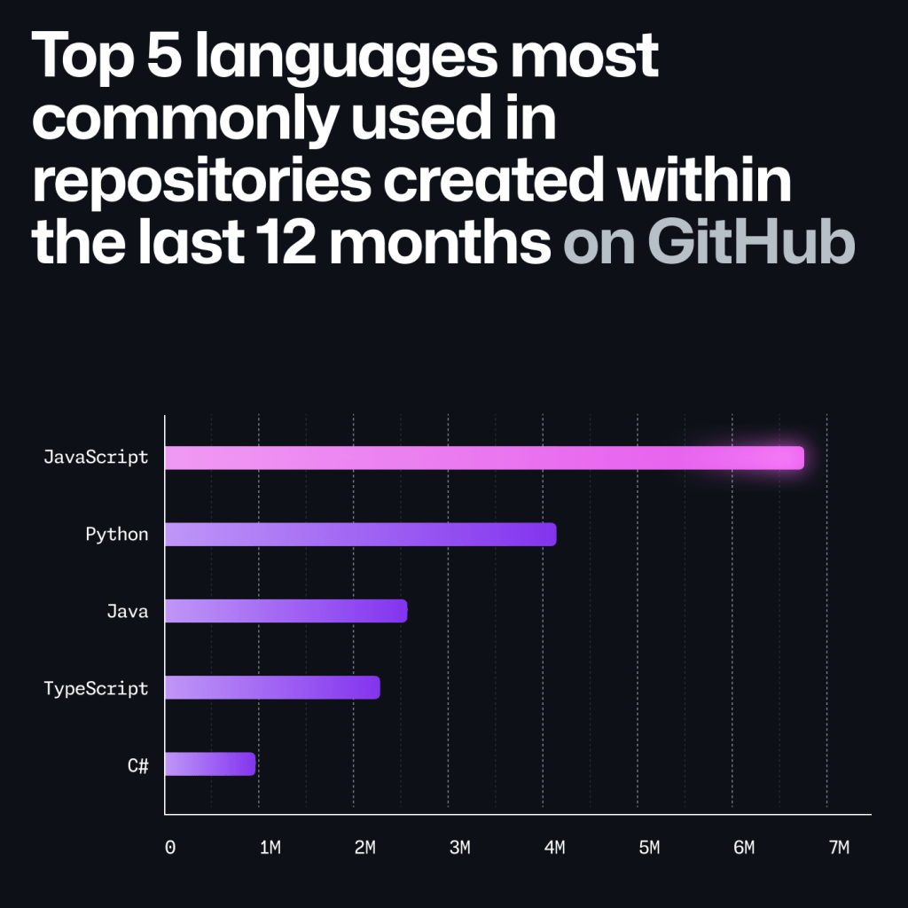
Why Focus on Python Over Other Languages?
Python was the most popular language for open source software projects on GitHub in 2024, and is still continuing to grow in popularity
“The rise in Python usage correlates with large communities of people joining the open source community from across the STEM world rather than the traditional community of software developers.”
Source for data and graphs: https://github.blog/news-insights/octoverse/octoverse-2024/

Slide 14
Using Python for Data Management
Look through all files in a directory
Open files and edit content
Bulk create, delete, move, and rename files and directories
Work with data in large spreadsheets
Retrieve data from external sources using an API
Schedule scripted tasks like automated data backup or publishing routines
Many more useful operations!

Slide 15
Installing Python Locally
Might already be on your computer due to it being included with your OS or other software
Be careful if you have multiple Python versions installed…
You can install Python using the default installer or you can use a package manager like Anaconda
Once Python is installed, you will likely want to install extra packages to extend the its functionality
You can do this with pip or with Anaconda
Using a virtual environment can help manage Python and package versions on your local machine
Notes:
Mac comes preinstalled with Python

Slide 16
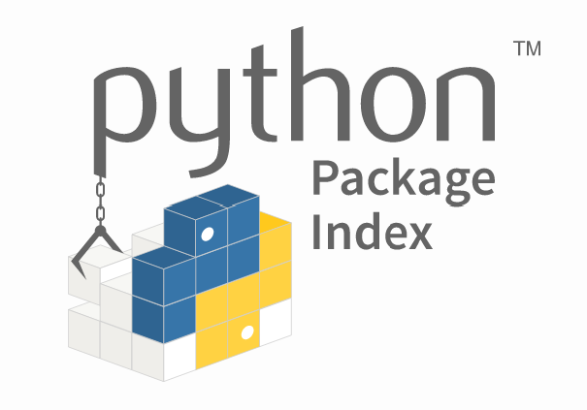
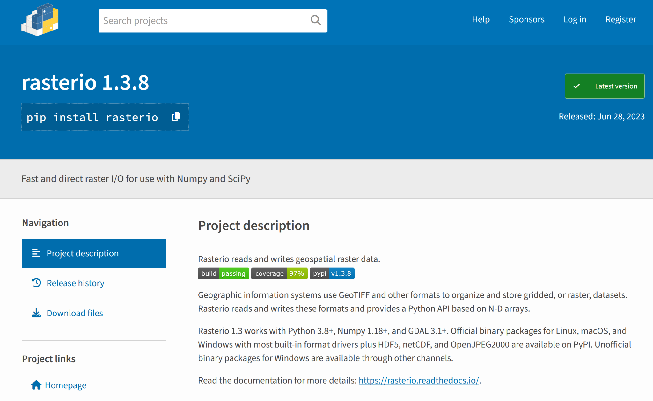
Installing New Python Packages
pip is the default package installer for Python
You can use pip to install packages from the Python Package Index and other indexes
Although generally safe, packages should always be vetted before installation and use
pip can be used to install packages if you are running Python locally or in Google Colab
Installing and uninstalling packages is simple and fast

Slide 17
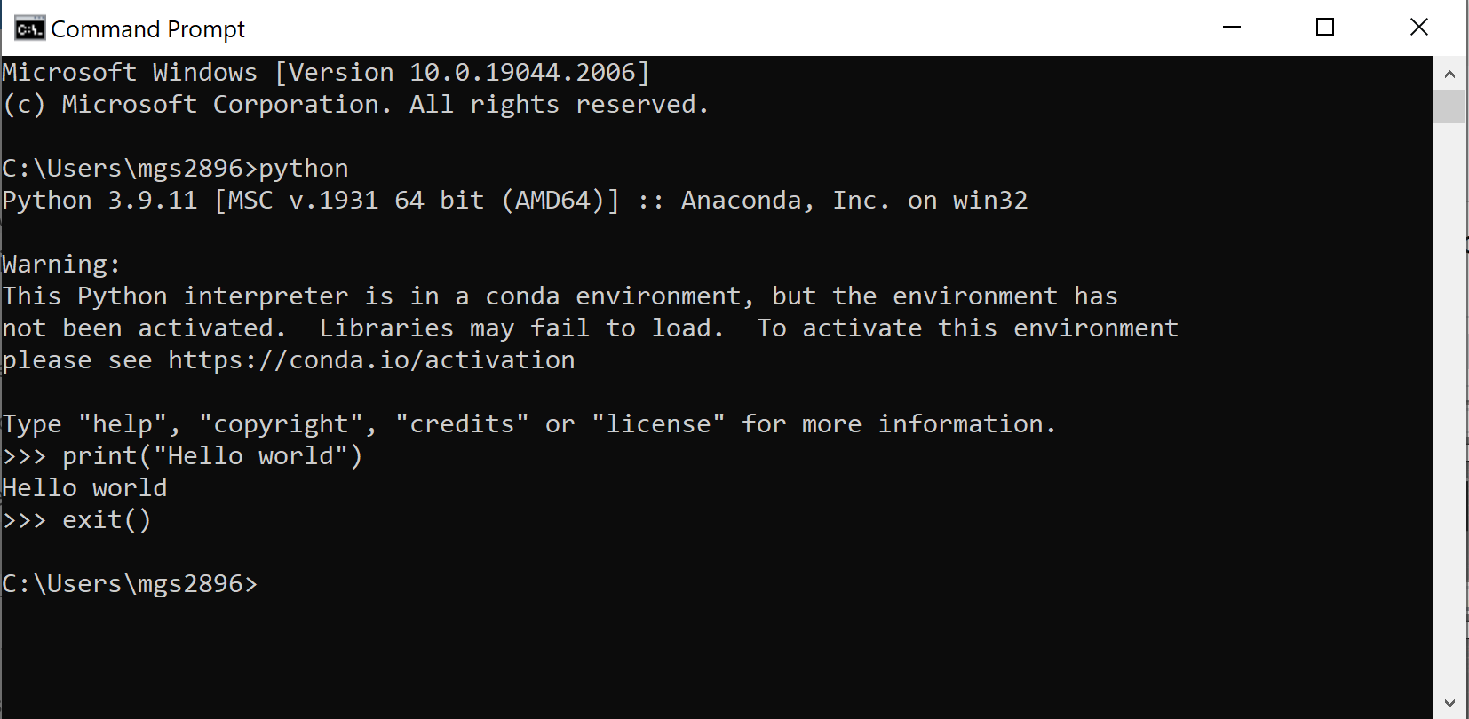
Integrated Development Environments (IDEs)
You can write Python code and run it from your Command Prompt or Terminal…

Slide 18
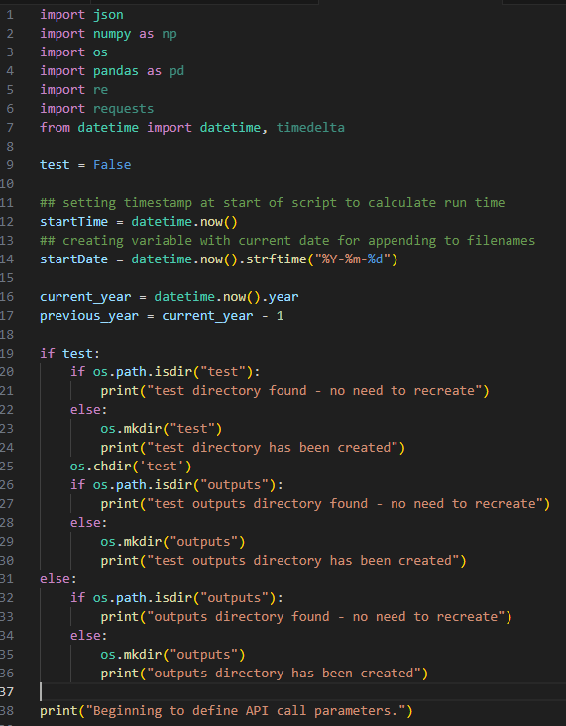





Integrated Development Environments (IDEs)
You can write Python code and run it from your Command Prompt or Terminal…but using an IDE makes writing code much easier
An IDE (integrated development environment) is a software solution designed to facilitate writing code
Jupyter (https://jupyter.org/)
VS Code (https://code.visualstudio.com/)
Pulsar (https://pulsar-edit.dev/)
PyCharm (https://www.jetbrains.com/pycharm/download/)
Spyder (https://www.spyder-ide.org/)

Slide 19
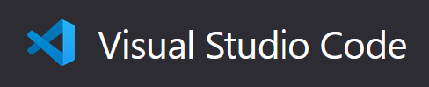
Using VS Code as your Python IDE
VS Code is a great IDE for Python because it is:
Free
Open source
Cross platform compatible
Widely utilized
Extensible and customizable
Download VS Code at https://code.visualstudio.com/

Slide 20

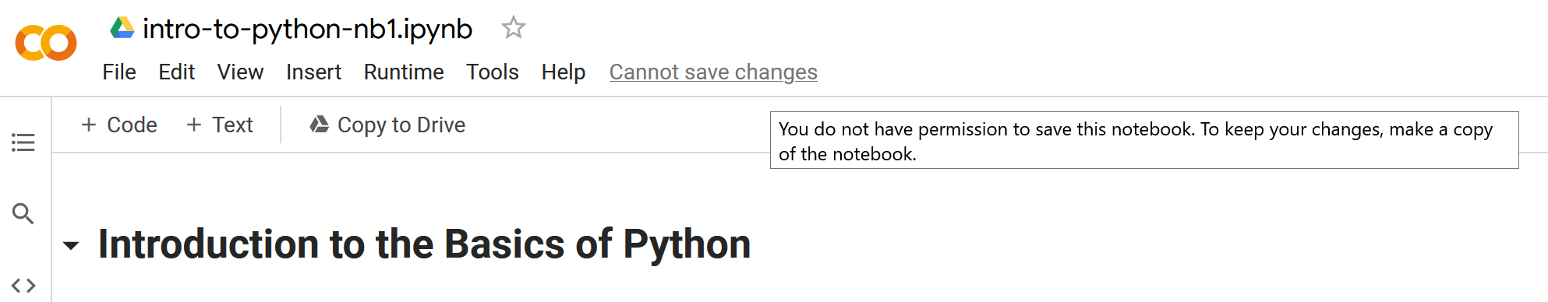
Google Colab
Colab is a free Google service that allows you to create and run Jupyter Notebooks in the cloud
Allows you to write Python code and text notes in compartmentalized cells within a notebook
Code cells can be run individually to allow for previewing outputs and troubleshooting issues
Notebooks are stored in Google Drive and can access other files in Google Drive
https://research.google.com/colaboratory/faq.html
Colab FAQs at https://research.google.com/colaboratory/faq.html

Slide 21
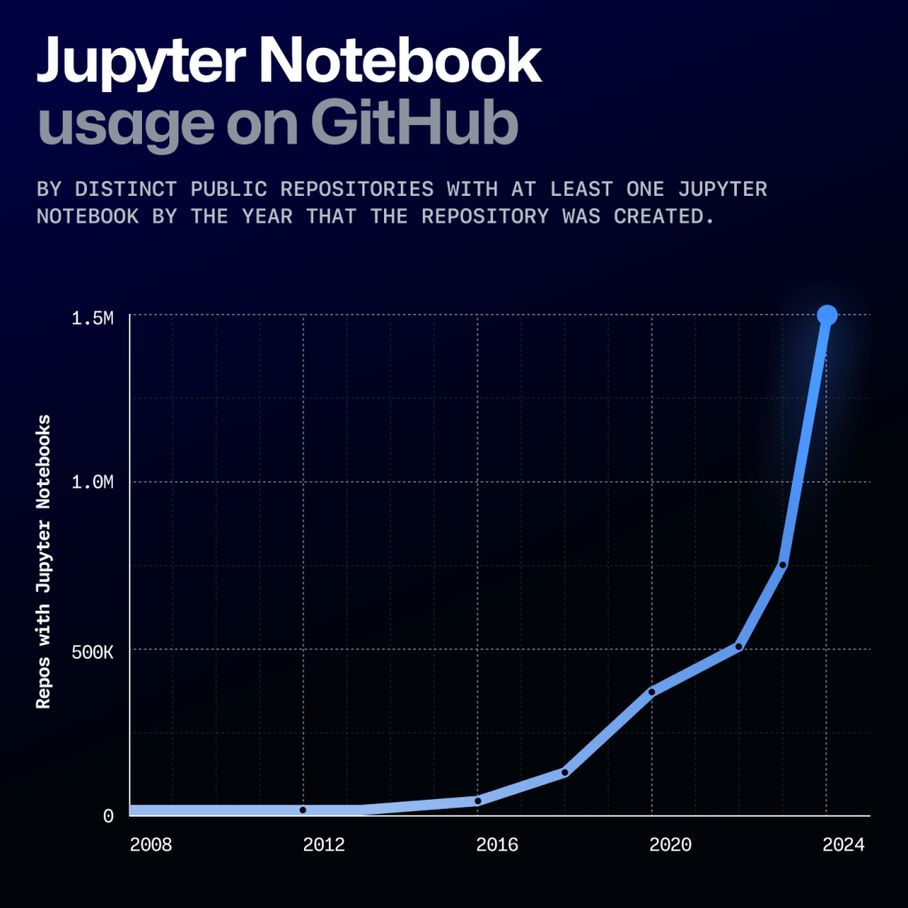
Google Colab

Slide 22
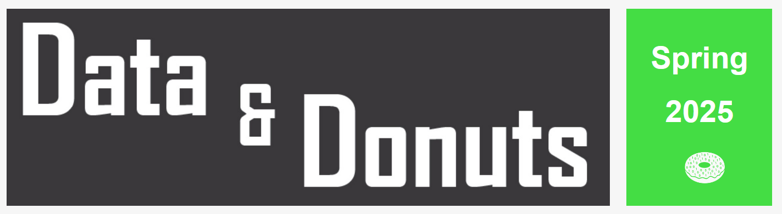
Further UTL Python Learning Opportunities
What Workshops covering research data practices and software
When On the following dates: 1/31, 2/11, 2/12, 2/13, 2/14, and 2/28
Time 12pm - 1:15pm
Where Zoom (all dates) / PCL Scholars Lab (select dates)
More info https://guides.lib.utexas.edu/data-and-donuts

Slide 23
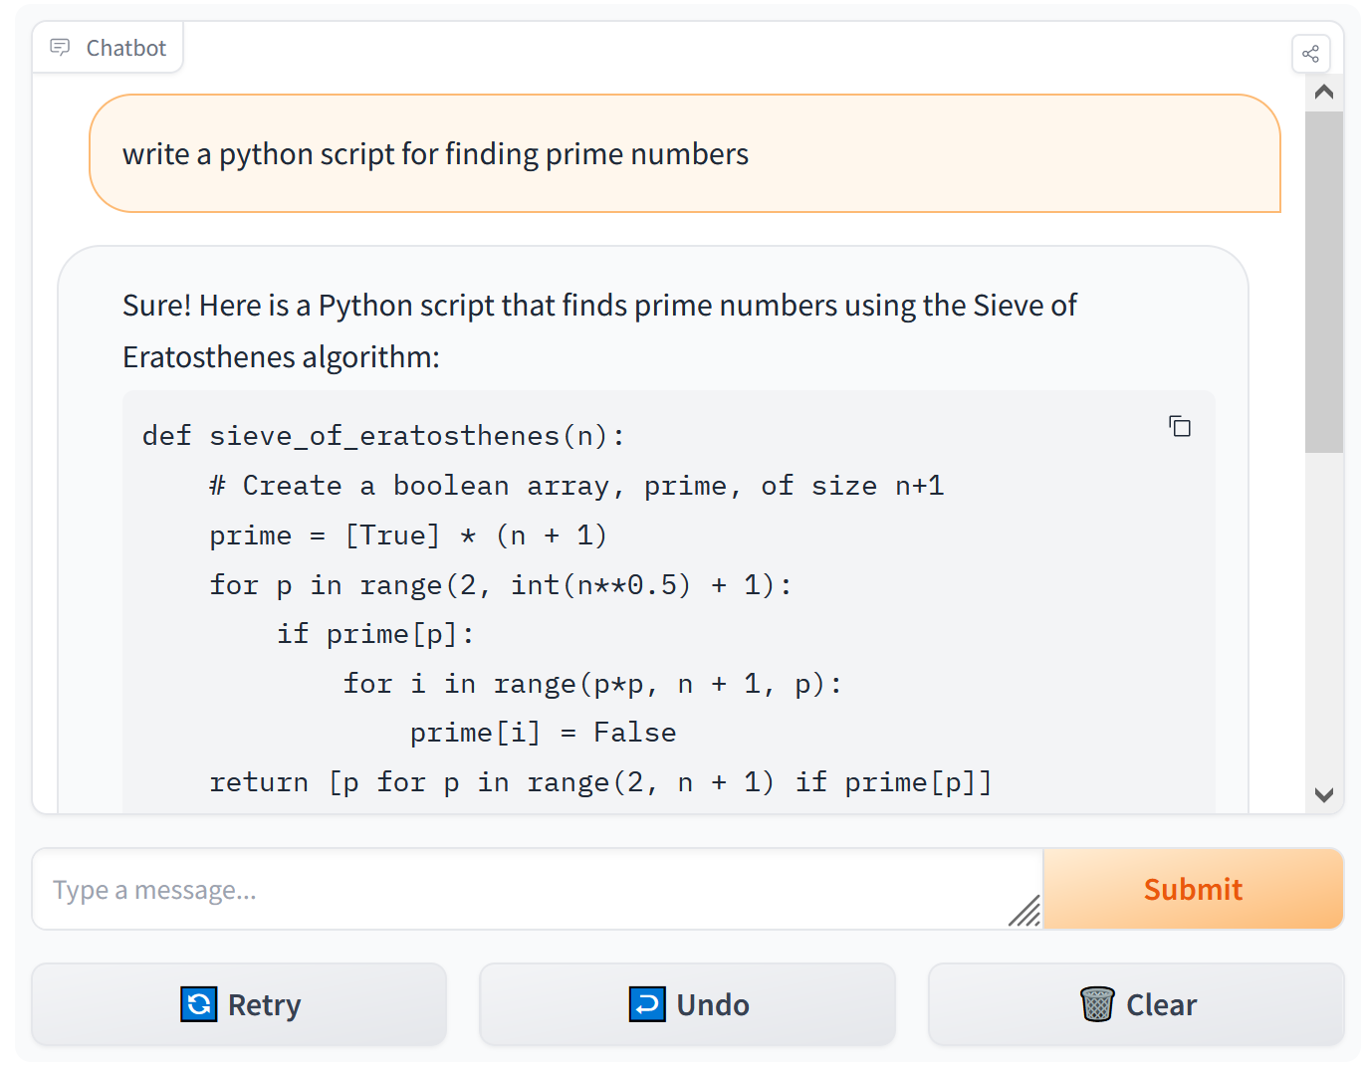
What About AI for Generating Code?
LLMs like Llama Code, ChatGPT, or Microsoft Copilot can generate code in response to a prompt
The code they generate may work, but often will not be as specific to your research questions as you may prefer and may need fixing or customization.
Having a strong knowledge of what you’re trying to accomplish and how to write and structure your own code is essential before using AI tools to supplement your programming.

Slide 24
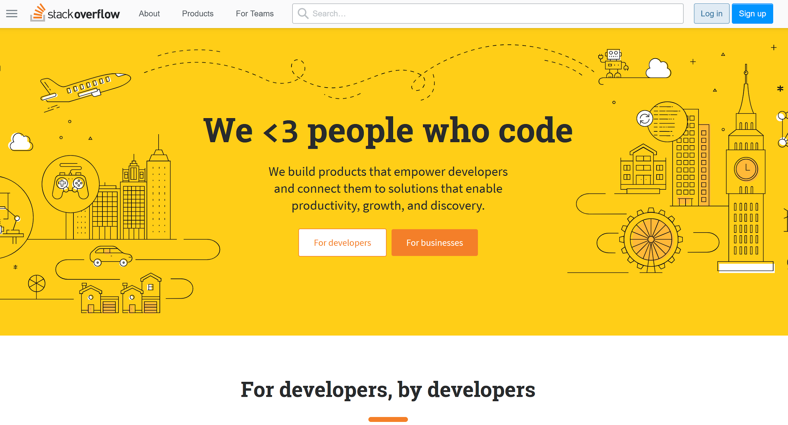
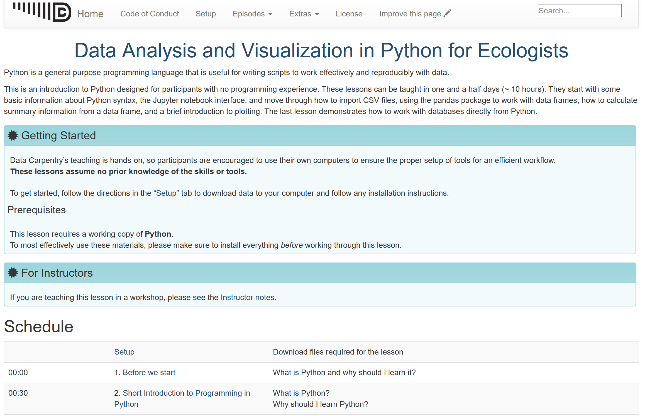
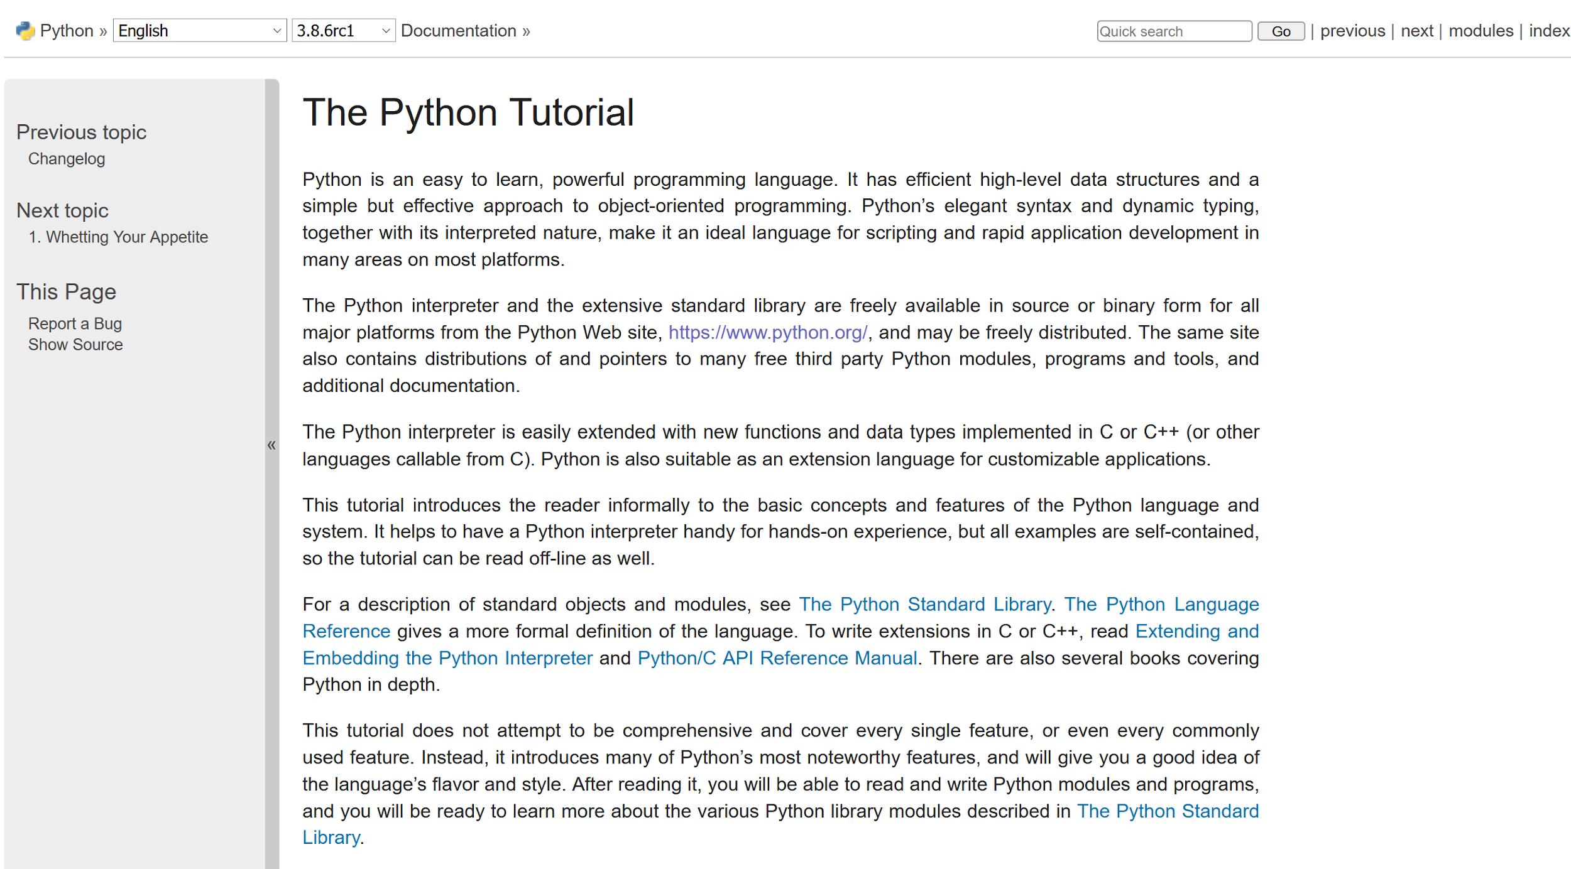
Python Resources, Documentation, and Help
Stack Overflow (https://stackoverflow.com/)
Data Carpentry (https://datacarpentry.org/python-ecology-lesson/)
Python Documentation (https://docs.python.org/3/library/index.html)
Python Tutorial (https://docs.python.org/3/tutorial/index.html)
LinkedIn Learning (https://www.linkedin.com/learning/topics/python)
UT Statistics Short Courses (https://stat.utexas.edu/training/software-short-courses)
Google Colab: Intro to Python (https://colab.research.google.com/notebooks/intro.ipynb)

Slide 25
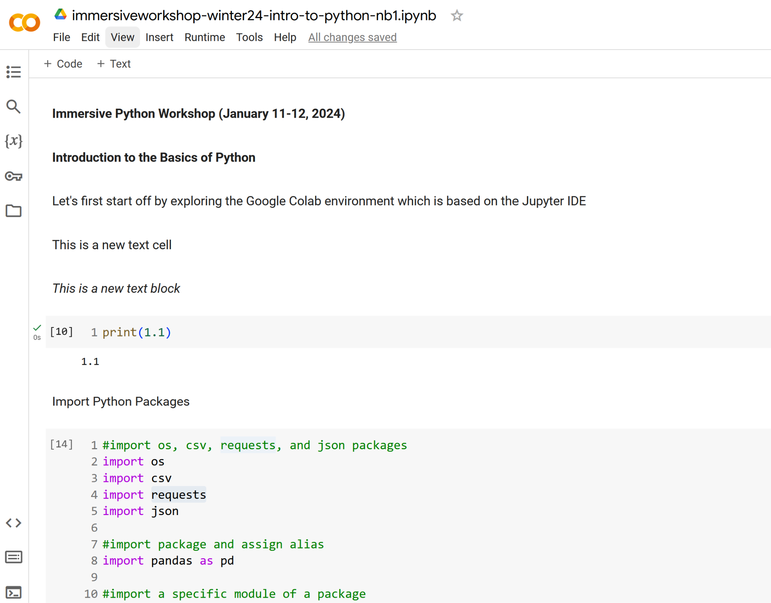
DEMO: Basics of Python for Reproducible Research
Python Basics
Packages and modules
Variables and object types
Operators
Methods and functions
Syntax
Comments
Conditional statements
Loops
Handle errors gracefully
Use this Colab Notebook to practice using Python to...
Create different types of Python objects
Utilize for loops
Write conditional statements
Use try and except to catch error
Define new functions
Retrieve data with the requests module
Link to publicly shared Google Colab Notebook: https://colab.research.google.com/drive/1v_lNLIjzIZmxgPG_2bgMT-qZB546NgU7#scrollTo=NO_W7wUspkUM

Slide 26
Software Installation Support

Slide 27
Software Installation Support
Python (https://www.python.org/downloads/)
Make sure you can install new Python packages using the Terminal (MacOS) or Command Prompt (Windows)
Try the following command on your PC: python -m pip install pandas
Try the following command on your Mac: python3 -m pip install pandas
VSCode (https://code.visualstudio.com/download)
Create a new file with the extension .py (to designate the file as a Python script)
Try clicking the play/run button in the upper right corner of VSCode to run the script
Git (https://git-scm.com/downloads)
Github Desktop (https://desktop.github.com/download/)
See next slide for troubleshooting common issues

Slide 28
Software Installation Common Issues
Mac
ISSUE: you cannot run a Python script in VS Code
CAUSE: the Python default interpreter path is not set correctly
SOLUTION: In VSCode go to File > Preferences > Settings and search for the Python default interpreter path setting - when you find it, update the the value to the correct Python interpreter path. If you don’t know the path to the interpreter, open your Terminal, type python3, import sys, and the run sys.executable
PC
ISSUE: trying to run python in the command prompt opens the Windows Store
CAUSE: the directory containing your Python interpreter is not correctly listed in your system Environment Variables’ path listing
SOLUTION: use the full path to your Python interpreter in the Command Prompt. If you don’t know the path to the interpreter search on your file system until you find out where it is installed and then use the full path wrapped in quotation marks in the command prompt (e.g. use 'C:\\Program Files\\python\\python.exe' but note the exact path may be different on your computer)
Helpers can stay past 4pm today to help resolve issues - having everything working by start of Day 2 is important

